Slide 1
Analysis of Theater Customer Data: Model Evaluation & Insights
Chakrapani Gajji

Slide 2
Project Overview
Objective:
To develop machine learning models to analyze theater customer behavior and predict retention rates.
Evaluate various models for regression, classification, and clustering tasks to determine the best approach for customer retention prediction.
Dataset Overview:
The dataset includes customer demographics, transaction history, visit frequency, and behavior-related features.
Focus on predicting customer retention and segmenting customers based on their behavior patterns.

Slide 3
Data Preprocessing
Preprocessing Steps :
Handling Missing Data: Imputed missing values for categorical and numerical variables.
Feature Encoding: Categorical variables were encoded using one-hot encoding.
Normalization & Scaling: Numerical features were scaled for model consistency.
Exploratory Data Analysis (EDA):
Distribution and correlations of features like age, frequency of visits, and customer preferences.

Slide 4
Classification Models Built
Models Used:
Decision Tree Classifier
Logistic Regression
Random Forest Classifier
Evaluation Metrics:
Accuracy, Precision, Recall, F1-Score, AUC (ROC) to evaluate model performance.

Slide 5
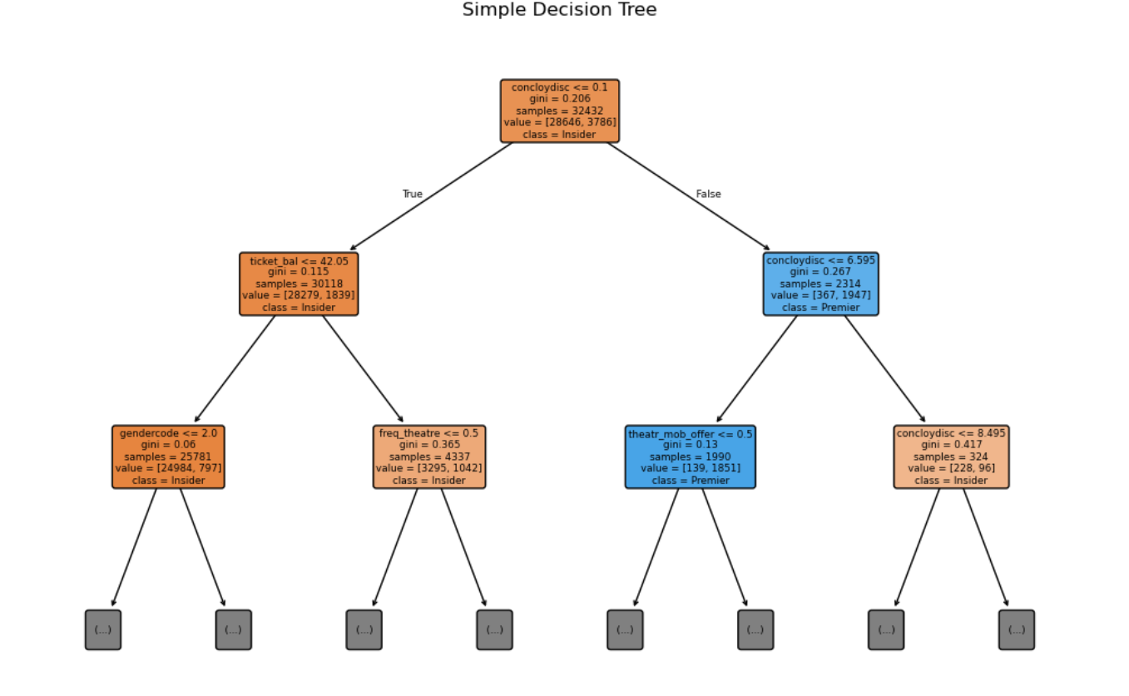
Decision Tree Classifier

Slide 6
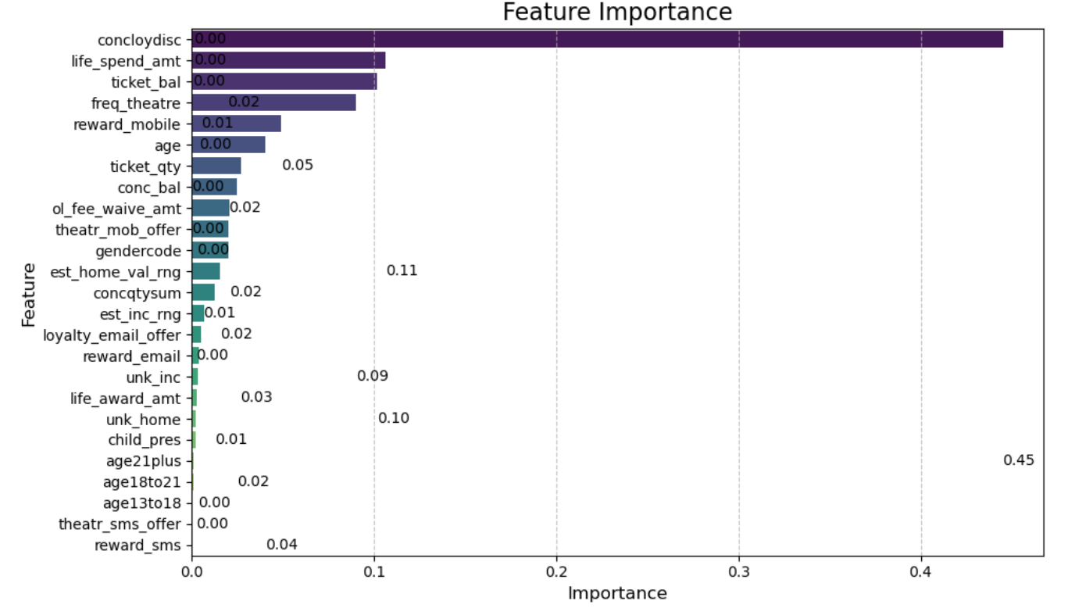
FEATURE IMPORTANCE

Slide 7
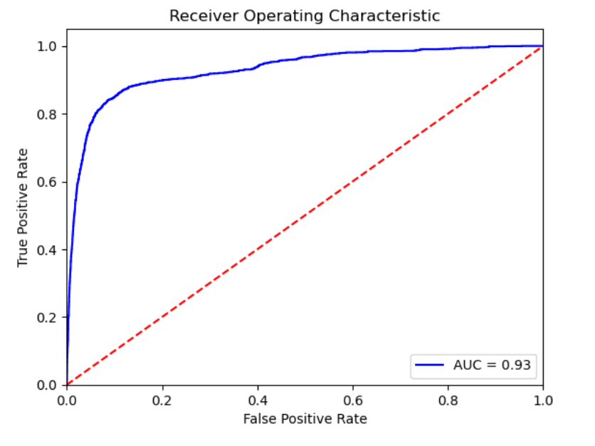
Logistic Regression

Slide 8
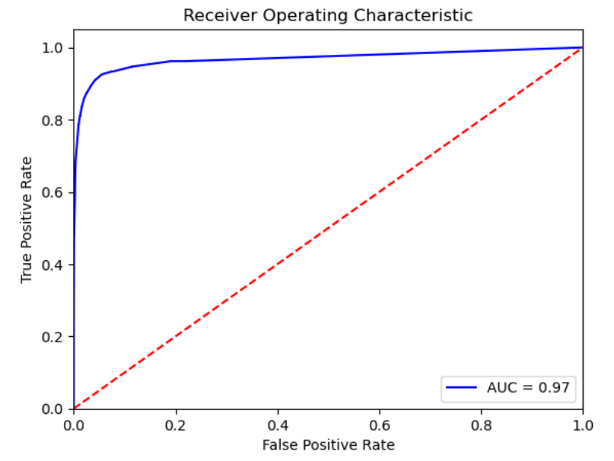
Random forest classifier

Slide 9
Classification Model Performance
Model | Accuracy | Precision | Recall | F1-Score | AUC (ROC)
Logistic Regression | 0.93 | 0.87 | 0.75 | 0.79 | 0.93
Decision Tree Classifier | 0.95 | 0.89 | 0.88 | 0.89 | 0.88
Random Forest Classifier | 0.97 | 0.94 | 0.89 | 0.91 | 0.97
Metrics Comparison:
Best Model Insight: Random Forest Classifier achieved the highest accuracy (0.97) and AUC (0.97), confirming it as the best model for customer retention prediction.

Slide 10
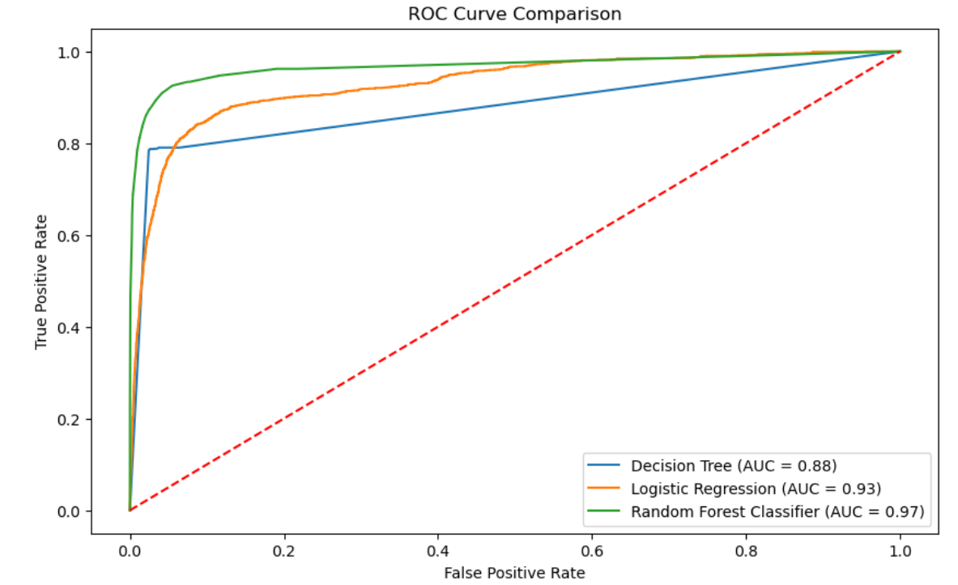
ROC Curve

Slide 11
Regression Models Built
Models Used:
Linear Regression
Random Forest Regression
Evaluation Metrics:
R-Squared, MSE, RMSE, MAE for assessing model accuracy and predictive performance.

Slide 12
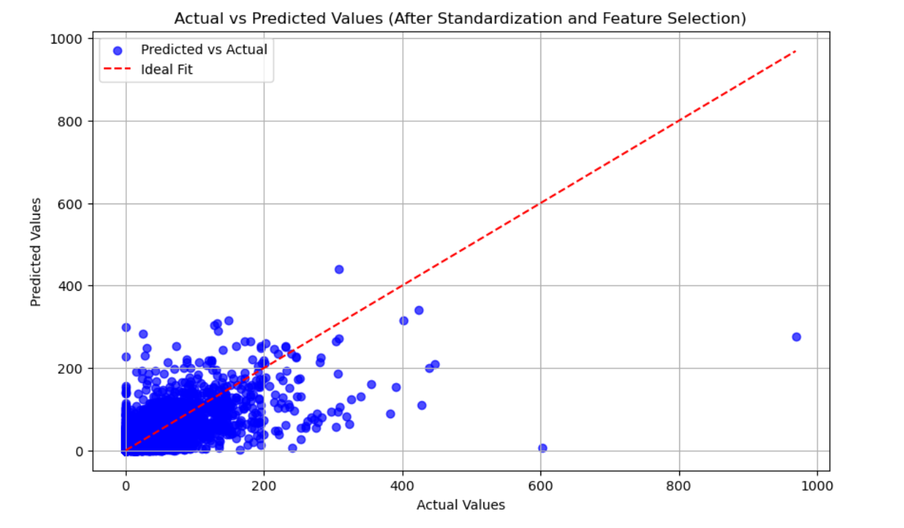
Random forest regressor

Slide 13
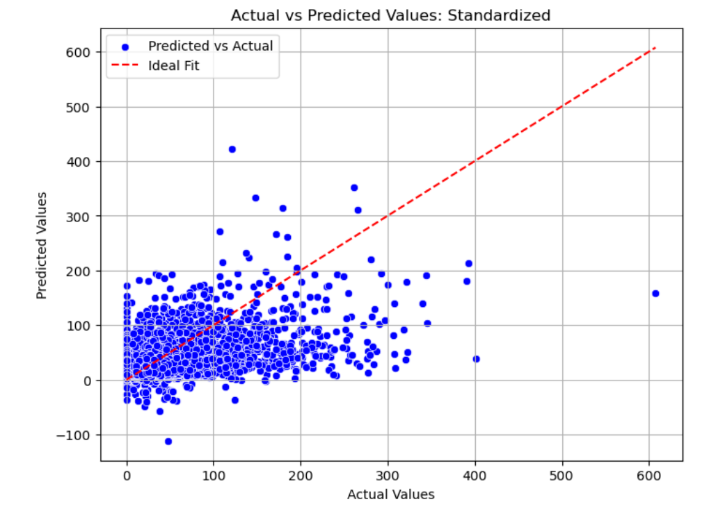
Linear regression

Slide 14
Regression Model Performance
Model | R-Squared | MSE | RMSE
Linear Regression | 0.31 | 1034.93 | 32.17
Random Forest Regression | 0.53 | 766.48 | 27.69
Best Model Insight: Random Forest Regression outperformed other models with an R-Squared of 0.53, offering the most accurate predictions for customer retention.

Slide 15
Clustering Models Built
Models Used:
K-Means Clustering
Evaluation Metrics:
Elbow Methos for Optimal k-value.
Silhouette Score
Accuracy : 0.99

Slide 16
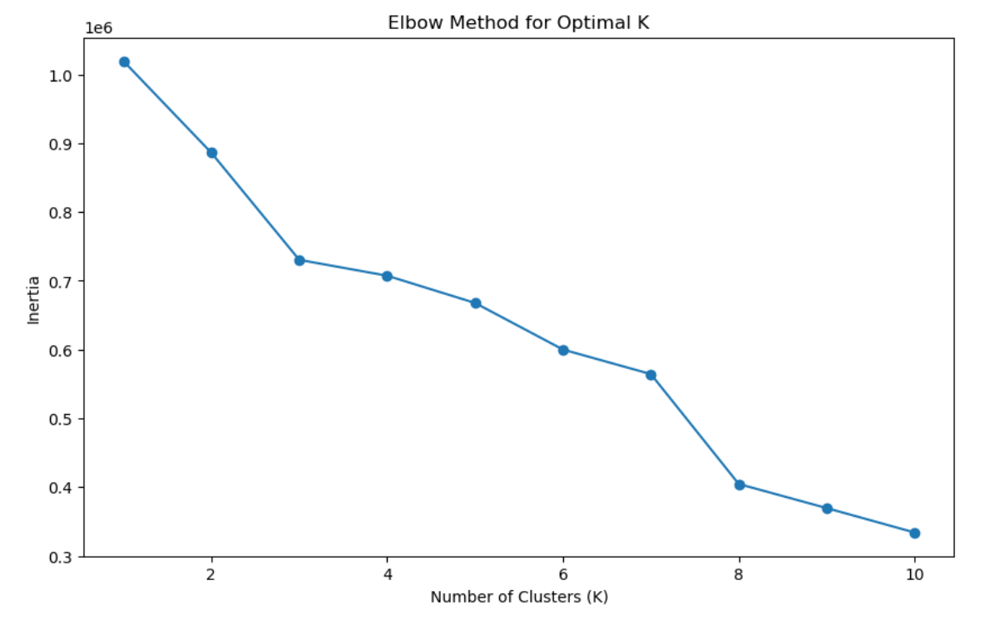
Elbow method for optimal k value

Slide 17
Customer Profile Table
Cluster | Age Group | Gender | Loyalty Offer Preference | Reward Offer Preferences | Theater Mobile Offer | Estimated Home Value Range | Ticket Balance | Cluster Size
0 | 21+ | Predominantly Male | High engagement with rewards via email and mobile | Strong engagement with reward offers (email, mobile, SMS) | High likelihood of receiving theater mobile offer | Moderate estimated home value range | Low ticket balance | 21,064
1 | 18-21 | Balanced Gender Distribution | Moderate engagement with loyalty and reward offers | Moderate reward offer engagement | Low likelihood of receiving theater offers | Low estimated home value range | Moderate ticket balance | 17,211
2 | 13-18 | Predominantly Female | Moderate loyalty and reward engagement | High engagement with reward offers (mobile, email) | Very low likelihood of receiving theater offers | High estimated home value range | High ticket balance | 8,056

Slide 18
Clustering Model Performance
Model | Silhouette Score | Davies-Bouldin Index | ARI
K-Means Clustering | 0.75 | 1.02 | 0.60
Metrics Comparison:
Best Model Insight: K-Means Clustering achieved the highest silhouette score (0.75), indicating distinct customer segments that are meaningful for targeted marketing.

Slide 19
Who are the customers that are likely to convert to Premier?
Customers most likely to upgrade to Premier are younger (aged 25-40), with higher spending habits and consistent usage patterns. They often belong to mid- or upper-wealth categories and are more willing to invest in premium services. Positive interactions with customer support play a significant role, as satisfied customers are more inclined to upgrade. Additionally, long-term loyal users who have been with the service for several years are more likely to transition to Premier. These customers demonstrate readiness for premium offerings through their spending behavior, loyalty, and engagement with the service.

Slide 20
Who are the customers that utilize Premier?
Premier customers are high-value clients who prefer premium services. They are typically older (above 35 years), have higher incomes, and are willing to pay for enhanced experiences. These customers show strong loyalty, having been with the brand for a longer time, and frequently engage with the service through frequent usage and numerous transactions. Their consistent engagement and spending patterns highlight the value they derive from Premier offerings, making them ideal candidates for premium services.

Slide 21
Who are the customers that utilize Insider?
Insider customers are younger individuals (20-30 years old) who are exploring the brand and testing services before committing to premium options. They often belong to lower or mid-wealth segments, are more price-sensitive, and engage less frequently with the service. These customers typically use basic features, show interest in discounts and special offers, and have a shorter history with the brand. They are cost-conscious but still curious about premium experiences, making them frequent trial users or occasional customers.

Slide 22
Thank you

